Slide 1
Elementary Linear Algebra
Howard Anton ＆ Chris Rorres

Slide 2

Chapter Contents
1.1 Introduction to System of Linear
Equations
1.2 Gaussian Elimination
1.3 Matrices and Matrix Operations
1.4 Inverses; Rules of Matrix Arithmetic
1.5 Elementary Matrices and a Method for
Finding
1.6 Further Results on Systems of Equations
and Invertibility
1.7 Diagonal, Triangular, and Symmetric
Matrices

Slide 3
1.1 Introduction to
Systems of Equations

Slide 4
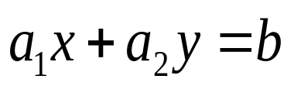
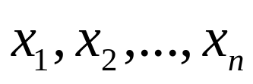
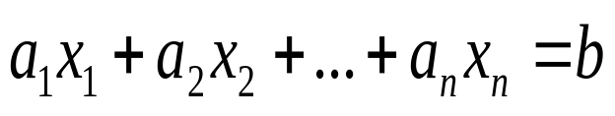

Linear Equations
Any straight line in xy-plane can be represented algebraically by an equation of the form:
General form: define a linear equation in the n variables :
  Where and b are real constants.
  The variables in a linear equation are sometimes
called unknowns.

Slide 5
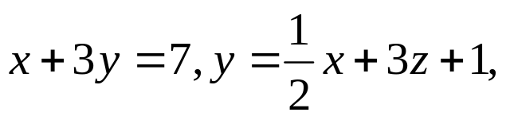

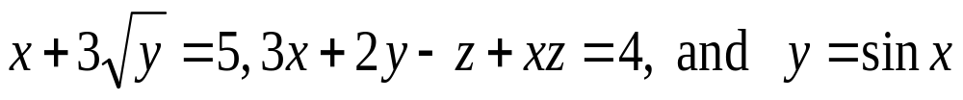
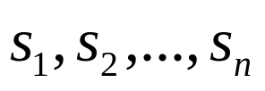
Example 1
Linear Equations
The equations and
are linear.
Observe that a linear equation does not involve any products or roots of variables. All variables occur only to the first power and do not appear as arguments for trigonometric, logarithmic, or exponential functions.
The equations
are not linear.
  A solution of a linear equation is a sequence of n numbers
  such that the equation is satisfied. The set of all solutions of the equation is called its solution set or general solution of the equation

Slide 6

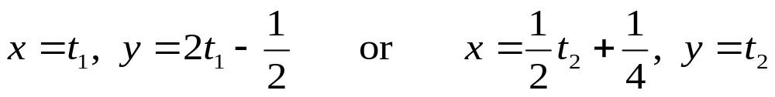
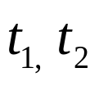
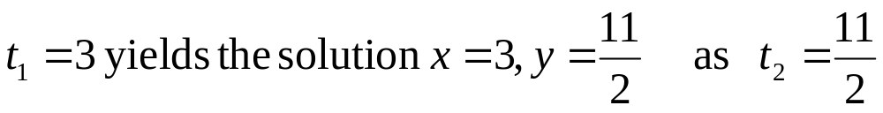
Example 2
Finding a Solution Set (1/2)
Find the solution of
Solution(a)
we can assign an arbitrary value to x and solve for y , or choose an arbitrary value for y and solve for x .If we follow the first approach and assign x an arbitrary value ,we obtain
  arbitrary numbers are called parameter.
  for example

Slide 7


Example 2
Finding a Solution Set (2/2)
Find the solution of
Solution(b)
we can assign arbitrary values to any two variables and solve for the third variable.
  for example
  where s, t are arbitrary values

Slide 8
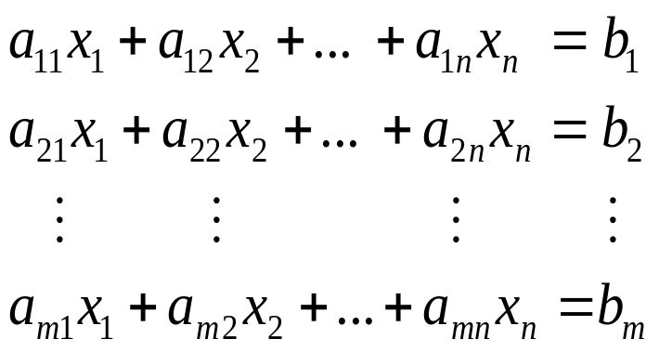
Linear Systems (1/2)
A finite set of linear equations in the variables
is called a system of linear equations or a linear system .
A sequence of numbers
is called a solution of the system.
A system has no solution is said to be inconsistent ; if there is at least one solution of the system, it is called consistent.
An arbitrary system of m linear equations in n unknowns

Slide 9
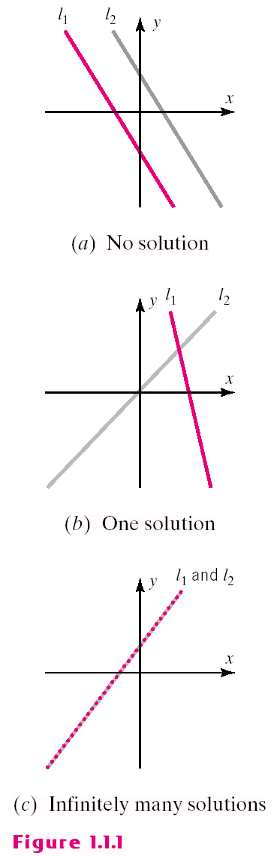
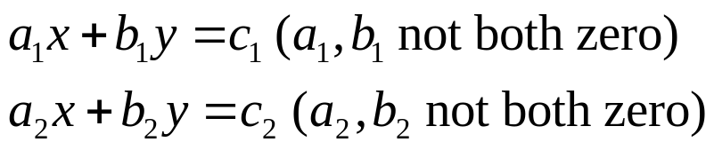
Linear Systems (2/2)
Every system of linear equations has either no solutions, exactly one solution, or infinitely many solutions.
A general system of two linear equations: (Figure1.1.1)
  Two lines may be parallel -> no solution
  Two lines may intersect at only one point
  -> one solution
  Two lines may coincide
  -> infinitely many solution

Slide 10
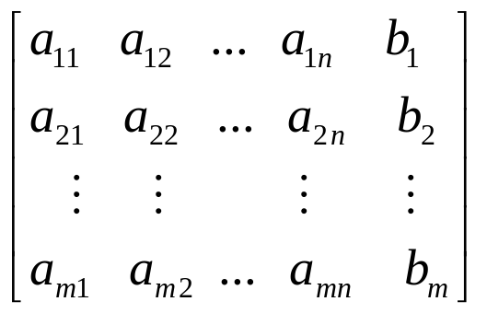
Augmented Matrices
The location of the +’s, the x’s, and the =‘s can be abbreviated by writing only the rectangular array of numbers.
This is called the augmented matrix for the system.
Note: must be written in the same order in each equation as the unknowns and the constants must be on the right.
1th column
1th row

Slide 11
Elementary Row Operations
The basic method for solving a system of linear equations is to replace the given system by a new system that has the same solution set but which is easier to solve.
Since the rows of an augmented matrix correspond to the equations in the associated system. new systems is generally obtained in a series of steps by applying the following three types of operations to eliminate unknowns systematically. These are called elementary row operations.
1. Multiply an equation through by an nonzero constant.
2. Interchange two equation.
3. Add a multiple of one equation to another.

Slide 12
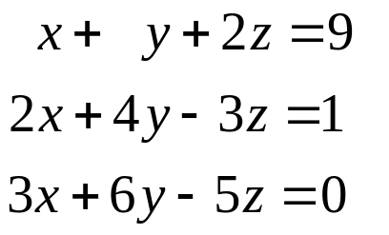
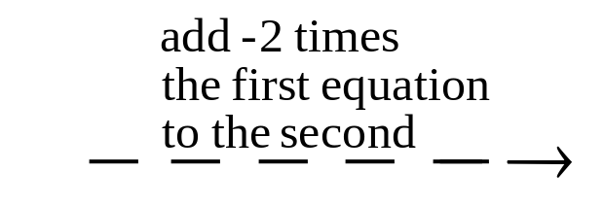
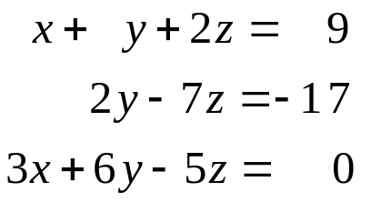
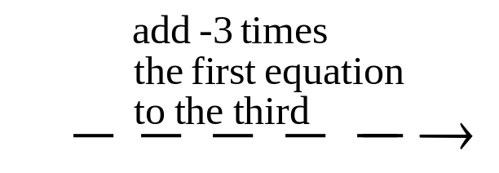
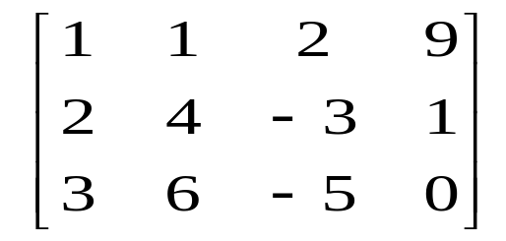
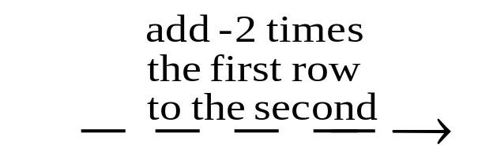
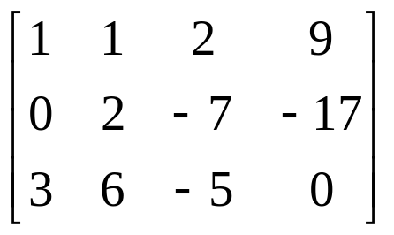
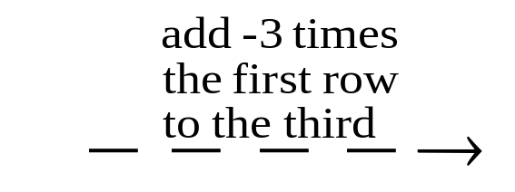
Example 3
Using Elementary row Operations(1/4)

Slide 13
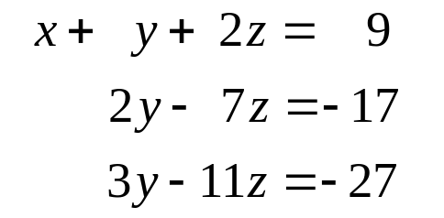
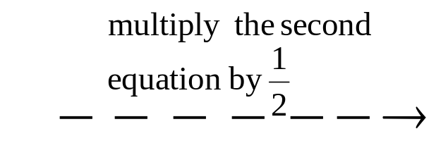
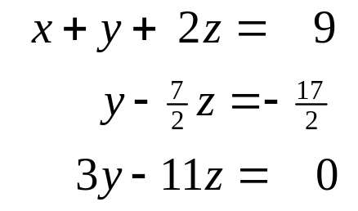
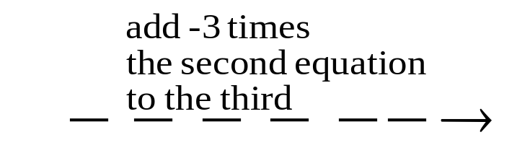
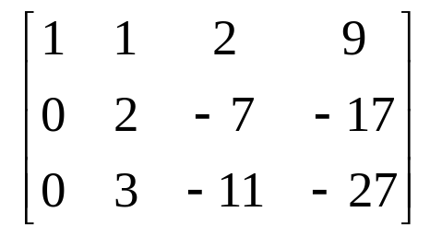
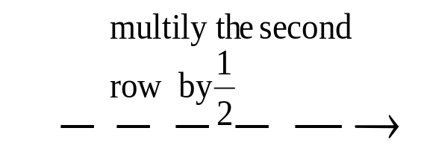
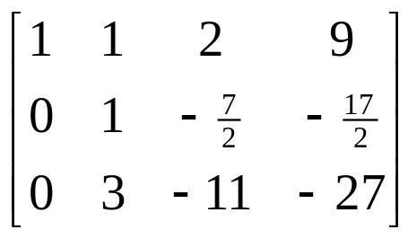
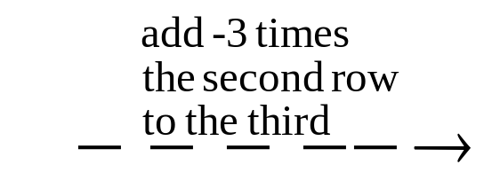
Example 3
Using Elementary row Operations(2/4)

Slide 14
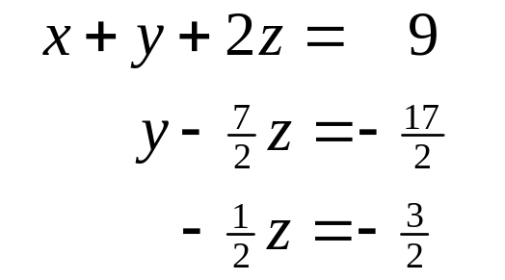
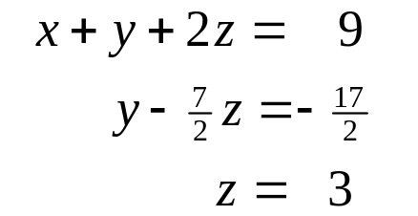
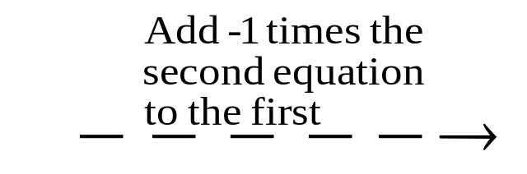
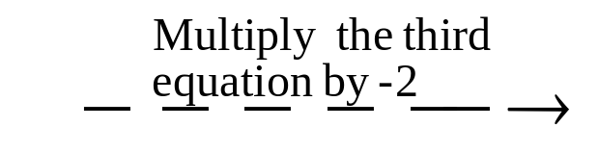
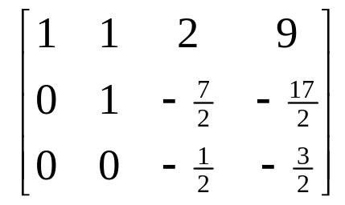
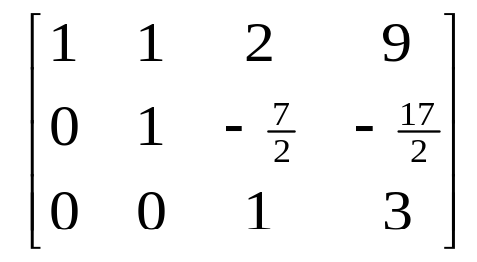
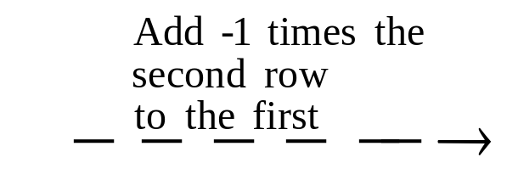
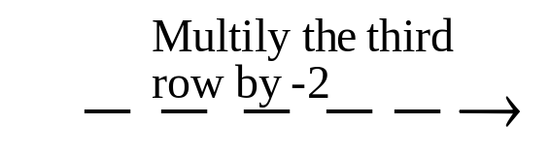
Example 3
Using Elementary row Operations(3/4)

Slide 15
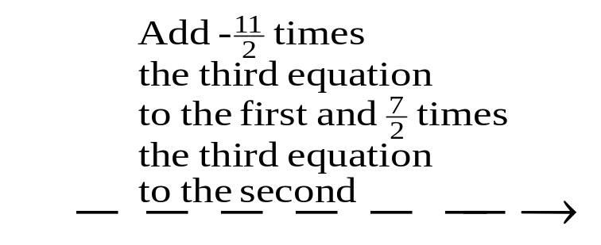
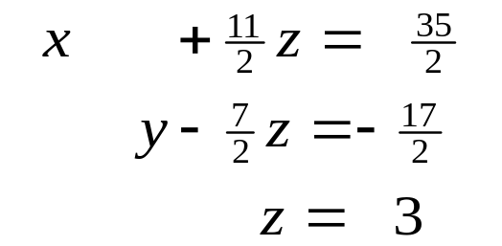
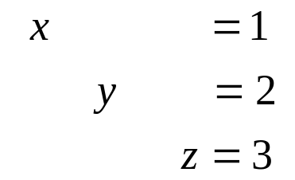
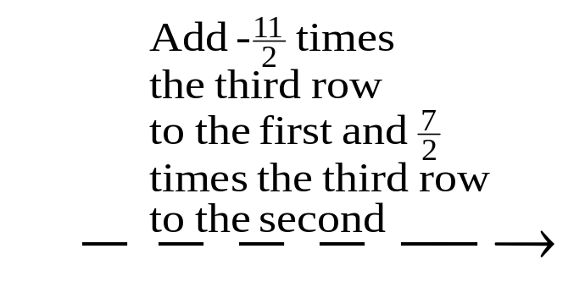
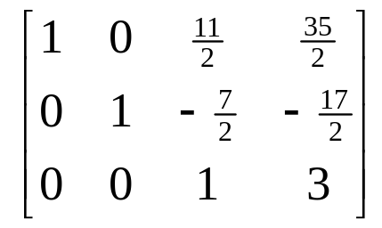
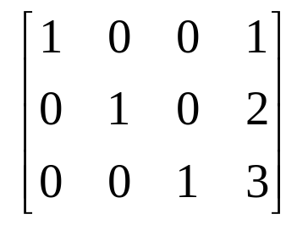
Example 3
Using Elementary row Operations(4/4)
The solution x=1,y=2,z=3 is now evident.

Slide 16
1.2 Gaussian Elimination

Slide 17
Echelon Forms
This matrix which have following properties is in reduced row-echelon form (Example 1, 2).
1. If a row does not consist entirely of zeros, then the first nonzero number in the row is a 1. We call this a leader 1.
2. If there are any rows that consist entirely of zeros, then they are grouped together at the bottom of the matrix.
3. In any two successive rows that do not consist entirely of zeros, the leader 1 in the lower row occurs farther to the right than the leader 1 in the higher row.
4. Each column that contains a leader 1 has zeros everywhere else.
A matrix that has the first three properties is said to be in row-echelon form (Example 1, 2).
A matrix in reduced row-echelon form is of necessity in row-echelon form, but not conversely.

Slide 18
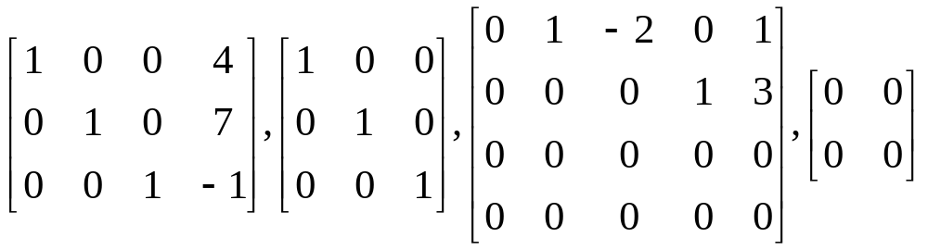
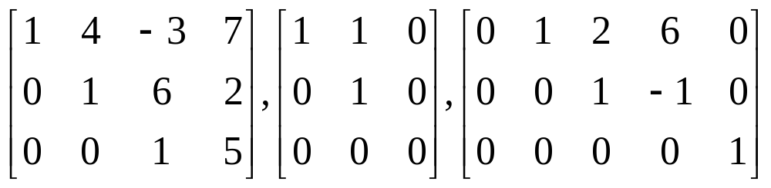
Example 1
Row-Echelon & Reduced Row-Echelon form
reduced row-echelon form:
row-echelon form:

Slide 19
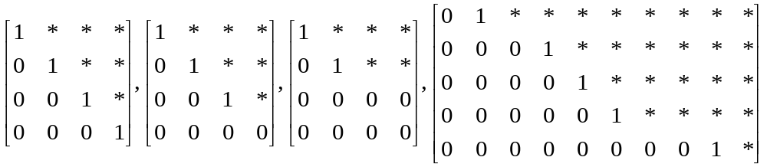
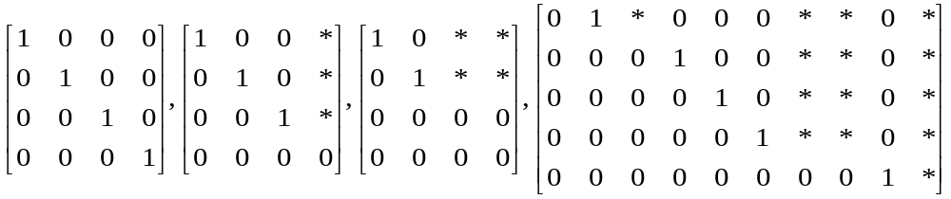
Example 2
More on Row-Echelon and Reduced Row-Echelon form
All matrices of the following types are in row-echelon form ( any real numbers substituted for the *’s. ) :
All matrices of the following types are in reduced row-echelon form ( any real numbers substituted for the *’s. ) :

Slide 20

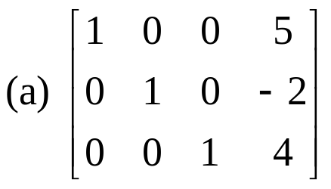
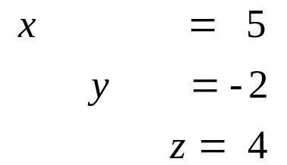
Example 3
Solutions of Four Linear Systems (a)
Suppose that the augmented matrix for a system of linear equations have been reduced by row operations to the given reduced row-echelon form. Solve the system.
Solution (a)
the corresponding system of equations is :

Slide 21
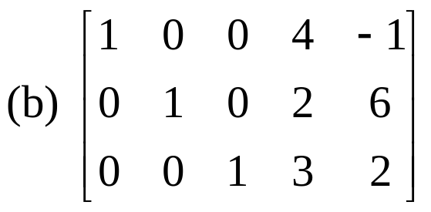

Example 3
Solutions of Four Linear Systems (b1)
Solution (b)
1. The corresponding system of equations is :
free variables
leading variables

Slide 22


Example 3
Solutions of Four Linear Systems (b2)
2. We see that the free variable can be assigned an arbitrary value, say t, which then determines values of the leading variables.
3. There are infinitely many solutions, and the general solution is given by the formulas

Slide 23


Example 3
Solutions of Four Linear Systems (c1)
Solution (c)
The 4th row of zeros leads to the equation places no restrictions on the solutions (why?). Thus, we can omit this equation.

Slide 24


Example 3
Solutions of Four Linear Systems (c2)
Solution (c)
Solving for the leading variables in terms of the free variables:
3. The free variable can be assigned an arbitrary value,there are infinitely many solutions, and the general solution is given by the formulas.

Slide 25


Example 3
Solutions of Four Linear Systems (d)
Solution (d):
the last equation in the corresponding system of equation is
Since this equation cannot be satisfied, there is no solution to the system.

Slide 26

Elimination Methods (1/7)
We shall give a step-by-step elimination procedure that can be used to reduce any matrix to reduced row-echelon form.

Slide 27

Elimination Methods (2/7)
Step1. Locate the leftmost column that does not consist entirely of zeros.
Step2. Interchange the top row with another row, to bring a nonzero entry to top of the column found in Step1.
Leftmost nonzero column
The 1th and 2th rows in the preceding matrix were interchanged.

Slide 28


Elimination Methods (3/7)
Step3. If the entry that is now at the top of the column found in Step1 is a, multiply the first row by 1/a in order to introduce a leading 1.
Step4. Add suitable multiples of the top row to the rows below so that all entires below the leading 1 become zeros.
The 1st row of the preceding matrix was multiplied by 1/2.
-2 times the 1st row of the preceding matrix was added to the 3rd row.

Slide 29


Elimination Methods (4/7)
Step5. Now cover the top row in the matrix and begin again with Step1 applied to the submatrix that remains. Continue in this way until the entire matrix is in row-echelon form.
Leftmost nonzero column in the submatrix
The 1st row in the submatrix was multiplied by -1/2 to introduce a leading 1.

Slide 30


Elimination Methods (5/7)
Step5 (cont.)
-5 times the 1st row of the submatrix was added to the 2nd row of the submatrix to introduce a zero below the leading 1.
The top row in the submatrix was covered, and we returned again Step1.
Leftmost nonzero column in the new submatrix
The first (and only) row in the new submetrix was multiplied by 2 to introduce a leading 1.
The entire matrix is now in row-echelon form.

Slide 31



Elimination Methods (6/7)
Step6. Beginning with las nonzero row and working upward, add suitable multiples of each row to the rows above to introduce zeros above the leading 1’s.
7/2 times the 3rd row of the preceding matrix was added to the 2nd row.
-6 times the 3rd row was added to the 1st row.
5 times the 2nd row was added to the 1st row.
The last matrix is in reduced row-echelon form.

Slide 32
Elimination Methods (7/7)
Step1~Step5: the above procedure produces a row-echelon form and is called Gaussian elimination.
Step1~Step6: the above procedure produces a reduced row-echelon form and is called Gaussian-Jordan elimination.
Every matrix has a unique reduced row-echelon form but a row-echelon form of a given matrix is not unique.

Slide 33


Example 4
Gauss-Jordan Elimination(1/4)
Solve by Gauss-Jordan Elimination
Solution:
The augmented matrix for the system is

Slide 34


Example 4
Gauss-Jordan Elimination(2/4)
Adding -2 times the 1st row to the 2nd and 4th rows gives
Multiplying the 2nd row by -1 and then adding -5 times the new 2nd row to the 3rd row and -4 times the new 2nd row to the 4th row gives

Slide 35


Example 4
Gauss-Jordan Elimination(3/4)
Interchanging the 3rd and 4th rows and then multiplying the 3rd row of the resulting matrix by 1/6 gives the row-echelon form.
Adding -3 times the 3rd row to the 2nd row and then adding 2 times the 2nd row of the resulting matrix to the 1st row yields the reduced row-echelon form.

Slide 36


Example 4
Gauss-Jordan Elimination(4/4)
The corresponding system of equations is
Solution
The augmented matrix for the system is
We assign the free variables, and the general solution is given by the formulas:

Slide 37
Back-Substitution
It is sometimes preferable to solve a system of linear equations by using Gaussian elimination to bring the augmented matrix into row-echelon form without continuing all the way to the reduced row-echelon form.
When this is done, the corresponding system of equations can be solved by solved by a technique called back-substitution.
Example 5

Slide 38

Example 5 ex4 solved by Back-substitution(1/2)
From the computations in Example 4, a row-echelon form from the augmented matrix is
To solve the corresponding system of equations
Step1. Solve the equations for the leading variables.

Slide 39

Example5 ex4 solved by Back-substitution(2/2)
Step2. Beginning with the bottom equation and working upward, successively substitute each equation into all the equations above it.
  Substituting x6=1/3 into the 2nd equation
  Substituting x3=-2 x4 into the 1st equation
Step3. Assign free variables, the general solution is given by the formulas.

Slide 40
Example 6
Gaussian elimination(1/2)
Solve by Gaussian elimination and
back-substitution. (ex3 of Section1.1)
Solution
  We convert the augmented matrix
  to the ow-echelon form
  The system corresponding to this matrix is

Slide 41



Example 6
Gaussian elimination(2/2)
Solution
  Solving for the leading variables
  Substituting the bottom equation into those above
  Substituting the 2nd equation into the top

Slide 42


Homogeneous Linear Systems(1/2)
A system of linear equations is said
to be homogeneous if the constant
terms are all zero; that is , the
system has the form :
Every homogeneous system of linear equation is consistent, since all such system have
as a solution. This solution is called the trivial solution; if there are another solutions, they are called nontrivial solutions.
There are only two possibilities for its solutions:
  The system has only the trivial solution.
  The system has infinitely many solutions in addition to the trivial solution.

Slide 43


Homogeneous Linear Systems(2/2)
In a special case of a homogeneous linear system of two linear equations in two unknowns: (fig1.2.1)

Slide 44



Example 7
Gauss-Jordan Elimination(1/3)
Solve the following homogeneous system of linear equations by using Gauss-Jordan elimination.
Solution
  The augmented matrix
  Reducing this matrix to reduced row-echelon form

Slide 45


Example 7
Gauss-Jordan Elimination(2/3)
Solution (cont)
  The corresponding system of equation
  Solving for the leading variables is
  Thus the general solution is
  Note: the trivial solution is obtained when s=t=0.

Slide 46


Example7
Gauss-Jordan Elimination(3/3)
Two important points:
  Non of the three row operations alters the final column of zeros, so the system of equations corresponding to the reduced row-echelon form of the augmented matrix must also be a homogeneous system.
  If the given homogeneous system has m equations in n unknowns with m<n, and there are r nonzero rows in reduced row-echelon form of the augmented matrix, we will have r<n. It will have the form:

Slide 47
Theorem 1.2.1
A homogeneous system of linear equations with more unknowns than equations has infinitely many solutions.
  Note: theorem 1.2.1 applies only to homogeneous system
  Example 7 (3/3)

Slide 48
Computer Solution of Linear System
Most computer algorithms for solving large linear systems are based on Gaussian elimination or Gauss-Jordan elimination.
Issues
  Reducing roundoff errors
  Minimizing the use of computer memory space
  Solving the system with maximum speed

Slide 49
1.3 Matrices and
Matrix Operations

Slide 50
Definition
A matrix is a rectangular array of numbers. The numbers in the array are called the entries in the matrix.

Slide 51

Example 1
Examples of matrices
Some examples of matrices
Size
3 x 2, 1 x 4, 3 x 3, 2 x 1, 1 x 1
entries
row matrix or row vector
column matrix or column vector
# columns
# rows

Slide 52



Matrices Notation and Terminology(1/2)
A general m x n matrix A as
The entry that occurs in row i and column j of matrix A will be denoted . If is real number, it is common to be referred as scalars.

Slide 53



Matrices Notation and Terminology(2/2)
The preceding matrix can be written as
A matrix A with n rows and n columns is called a square matrix of order n, and the shaded entries
are said to be on the main diagonal of A.

Slide 54

Definition
Two matrices are defined to be equal if they have the same size and their corresponding entries are equal.

Slide 55

Example 2
Equality of Matrices
Consider the matrices
  If x=5, then A=B.
  For all other values of x, the matrices A and B are not equal.
  There is no value of x for which A=C since A and C have different sizes.

Slide 56

Operations on Matrices
If A and B are matrices of the same size, then the sum A+B is the matrix obtained by adding the entries of B to the corresponding entries of A.
Vice versa, the difference A-B is the matrix obtained by subtracting the entries of B from the corresponding entries of A.
Note: Matrices of different sizes cannot be added or subtracted.

Slide 57


Example 3
Addition and Subtraction
Consider the matrices
  Then
  The expressions A+C, B+C, A-C, and B-C are undefined.

Slide 58

Definition
If A is any matrix and c is any scalar, then the product cA is the matrix obtained by multiplying each entry of the matrix A by c. The matrix cA is said to be the scalar multiple of A.

Slide 59


Example 4
Scalar Multiples (1/2)
For the matrices
  We have
  It common practice to denote (-1)B by –B.

Slide 60

Example 4
Scalar Multiples (2/2)

Slide 61

Definition
If A is an m×r matrix and B is an r×n matrix, then the product AB is the m×n matrix whose entries are determined as follows.
To find the entry in row i and column j of AB, single out row i from the matrix A and column j from the matrix B .Multiply the corresponding entries from the row and column together and then add up the resulting products.

Slide 62


Example 5
Multiplying Matrices (1/2)
Consider the matrices
Solution
  Since A is a 2 ×3 matrix and B is a 3 ×4 matrix, the product AB is a 2 ×4 matrix. And:

Slide 63

Example 5
Multiplying Matrices (2/2)

Slide 64
Examples 6
Determining Whether a Product Is Defined
Suppose that A ,B ,and C are matrices with the following sizes:
A B C
3 ×4 4 ×7 7 ×3
Solution:
  Then by (3), AB is defined and is a 3 ×7 matrix; BC is defined and is a 4 ×3 matrix; and CA is defined and is a 7 ×4 matrix. The products AC ,CB ,and BA are all undefined.

Slide 65

Partitioned Matrices
A matrix can be subdivided or partitioned into smaller matrices by inserting horizontal and vertical rules between selected rows and columns.
For example, below are three possible partitions of a general 3 ×4 matrix A .
  The first is a partition of A into
  four submatrices A 11 ,A 12,
  A 21 ,and A 22 .
  The second is a partition of A
  into its row matrices r 1 ,r 2,
  and r 3 .
  The third is a partition of A
  into its column matrices c 1,
  c 2 ,c 3 ,and c 4 .

Slide 66


Matrix Multiplication by columns and by Rows
Sometimes it may b desirable to find a particular row or column of a matrix product AB without computing the entire product.
If a 1 ,a 2 ,...,a m denote the row matrices of A and b 1 ,b 2, ...,b n denote the column matrices of B ,then it follows from Formulas (6)and (7)that

Slide 67


Example 7
Example5 Revisited
This is the special case of a more general procedure for multiplying partitioned matrices.
If A and B are the matrices in Example 5,then from (6)the second column matrix of AB can be obtained by the computation
From (7) the first row matrix of AB can be obtained by the computation

Slide 68

Matrix Products as Linear Combinations (1/2)

Slide 69
Matrix Products as Linear Combinations (2/2)
In words, (10)tells us that the product A x of a matrix
A with a column matrix x is a linear combination of
the column matrices of A with the coefficients coming
from the matrix x .
In the exercises w ask the reader to show that the
product y A of a 1×m matrix y with an m×n matrix A
is a linear combination of the row matrices of A with
scalar coefficients coming from y .

Slide 70

Example 8
Linear Combination

Slide 71

Example 9
Columns of a Product AB as Linear Combinations

Slide 72



Matrix form of a Linear System(1/2)
Consider any system of m
linear equations in n unknowns.
Since two matrices are equal if
and only if their corresponding
entries are equal.
The m×1 matrix on the left side
of this equation can be written
as a product to give:

Slide 73


Matrix form of a Linear System(1/2)
If w designate these matrices by A ,x ,and b ,respectively, the original system of m equations in n unknowns has been replaced by the single matrix equation
The matrix A in this equation is called the coefficient matrix of the system. The augmented matrix for the system is obtained by adjoining b to A as the last column; thus the augmented matrix is

Slide 74

Definition
If A is any m×n matrix, then the transpose of A ,denoted by ,is defined to be the n×m matrix that results from interchanging the rows and columns of A ; that is, the first column of is the first row of A ,the second column of is the second row of A ,and so forth.

Slide 75

Example 10
Some Transposes (1/2)

Slide 76


Example 10
Some Transposes (2/2)
Observe that
In the special case where A is a square matrix, the transpose of A can be obtained by interchanging entries that are symmetrically positioned about the main diagonal.

Slide 77
Definition
If A is a square matrix, then the trace of A ,denoted by tr(A), is defined to be the sum of the entries on the main diagonal of A .The trace of A is undefined if A is not a square matrix.

Slide 78

Example 11
Trace of Matrix

